Slide 1
Montesano Jr-Sr High School
9th Grade Orientation

Slide 2
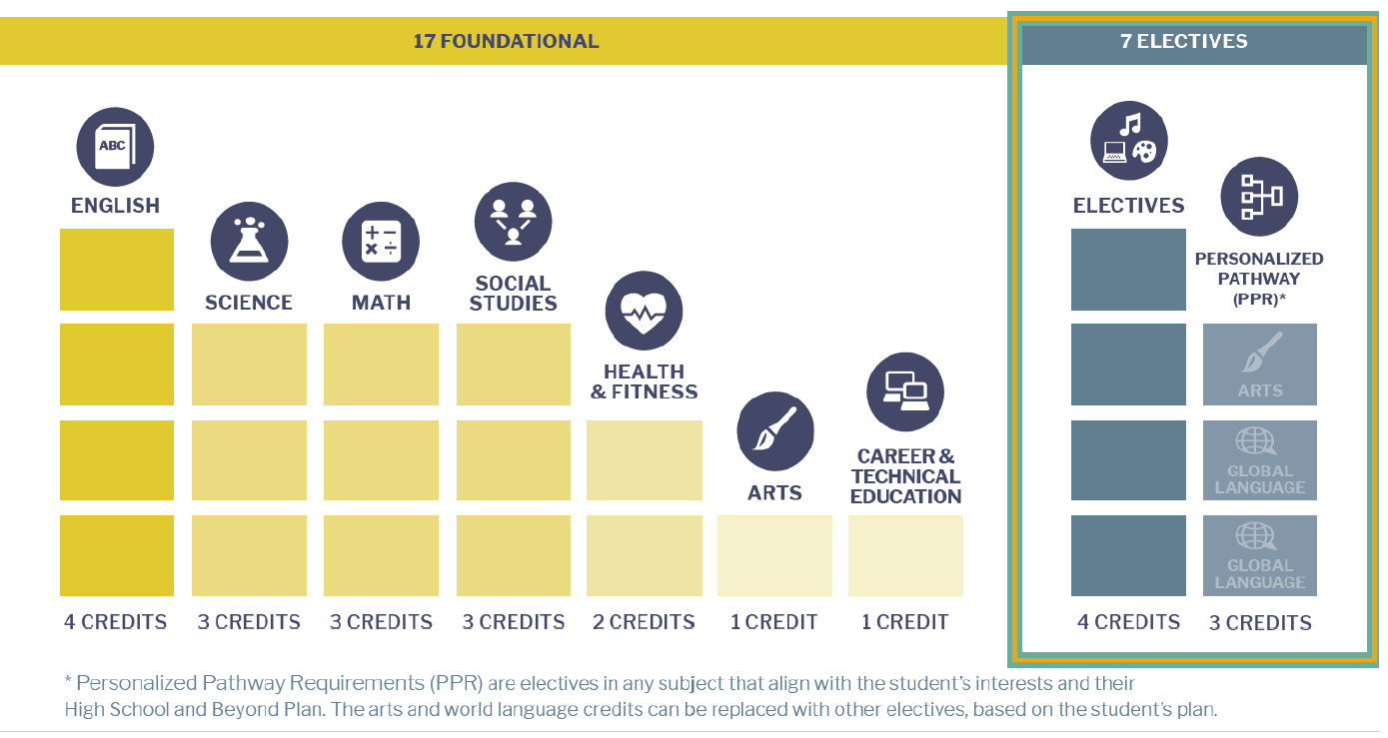
Graduation Requirements
Worksheet:
English - 4 credits
Math - 3 credits
Science - 3 credits
History - 3 credits
World Language/Personal Pathway – 2 cr
Fine Art - 2 credits
CTE – 1 credits
Physical Education/Health – 2 credits
Electives – 4 credits
Total 24 Credits

Slide 3
Freshmen Year
English: 1 credit
Math: 1 credit
Integrated Science: 1 credit
Physical Education/Health: 1 credit
Elective: 1 credit
Elective: 1 credit
Total: 6 credits

Slide 4
Scheduling
We will Add:
English
Math
Science
Choices:
PE or Weightlifting
Electives, 2 options for year long/Semester I, II

Slide 5
Fine Art classes
Art I Chorus
Art II Metal Sculpture
Graphic Design I Interior Design
Graphic Design II Foods I & II
Photography / Video Production I
Photography / Video Production II
Yearbook
Concert Band
Symphonic Band
Jazz Band

Slide 6
Career Technology Education
Art I Metal Shop II Careers in Education
Art II Metal Sculpture Fitness & Health Trainer
Graphic Design I Interior Design Health
Graphic Design II Child Development
Photography / Video Production I Foods I & II
Photography / Video Production II Business Procedures
Yearbook Accounting
American Sign Language I Marketing
American Sign Language II Project Management/Leadership
Intro to Shop Work Experience

Slide 7
Non CTE and fine art
Spanish

Slide 8
Personal Pathways/High School & Beyond Plan
My Student Data
Career Interest Inventory
Aligning Courses in High School
Apprenticeships
Two Year College
Four Year College/University
**Plans will change throughout their high school career

Slide 9
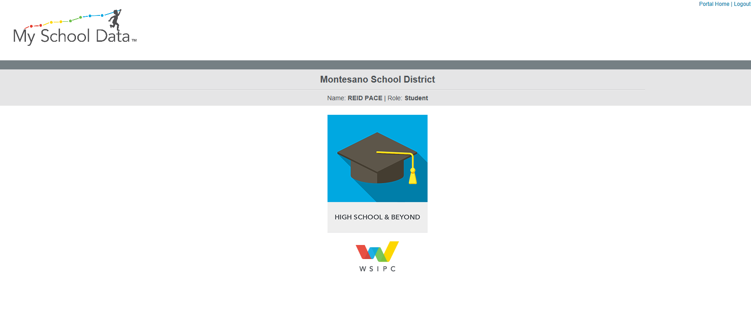

Slide 10
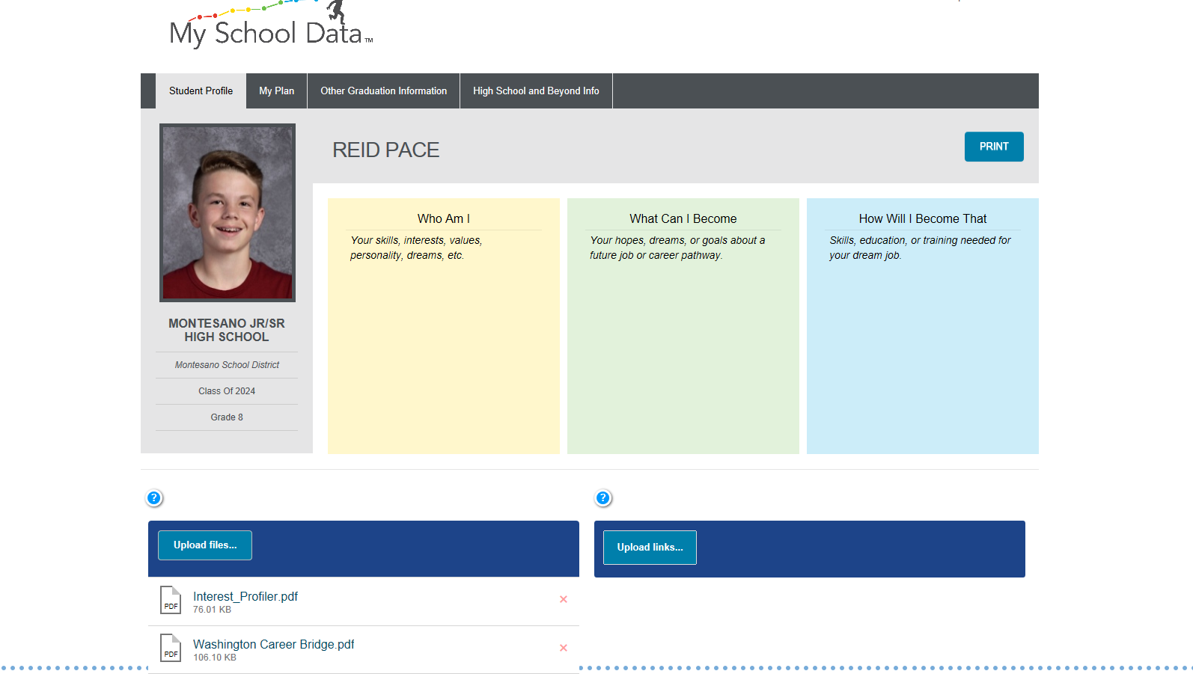

Slide 11
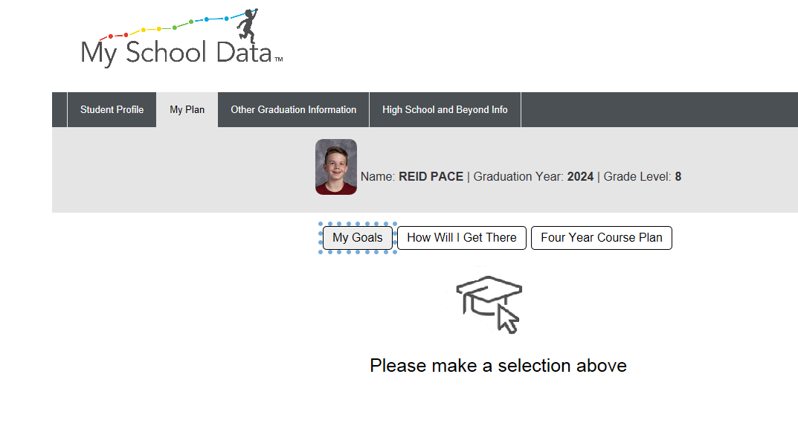

Slide 12
